Slide 1
Stock Market Prediction
Presented by: Aqsa Zubair

Slide 2
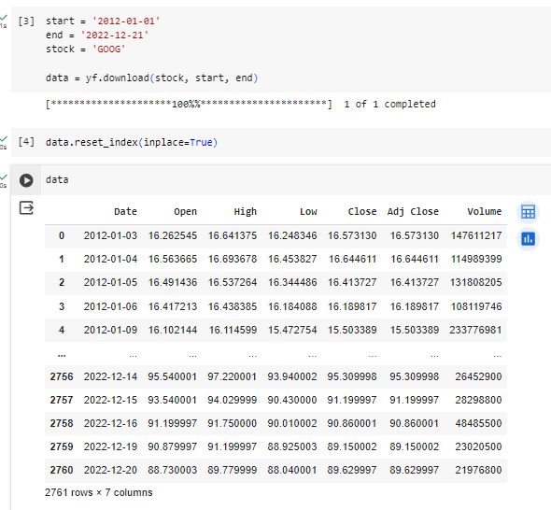
Data Fetching
These lines of code fetch historical stock market data for the Google stock (ticker symbol 'GOOG') from Yahoo Finance using the yfinance library.
In this case, data.reset_index(inplace=True) resets the index of the DataFrame data to a default range index and modifies the DataFrame in place.

Slide 3
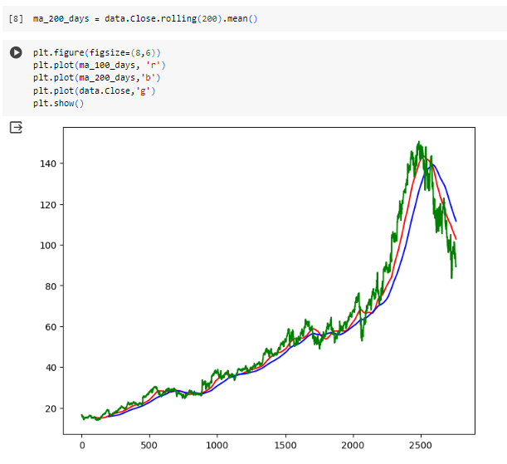
100-day and 200-day moving averages
100-day moving average (in red), the 200-day moving average (in blue), and the actual closing prices (in green) overlaid on the same graph.

Slide 4
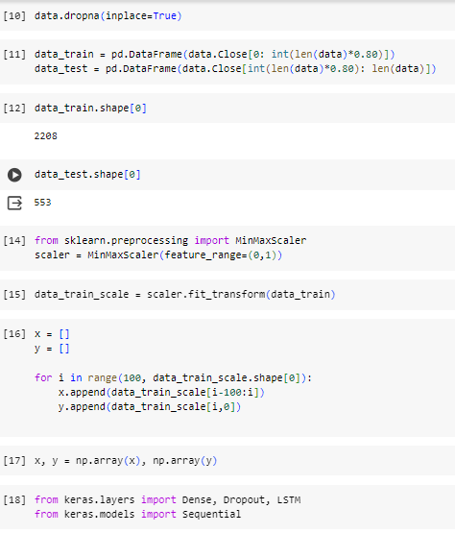
Data Splitting and Min-Max scaling
Split the data into training and testing sets based on the 'Close' prices of the stock data. The training set contains the initial 80% of the data, while the testing set contains the remaining 20%.
prepare the scaled input features and target values for training a machine learning model, such as a recurrent neural network (RNN) or long short-term memory (LSTM) network, on the historical stock price data.

Slide 5
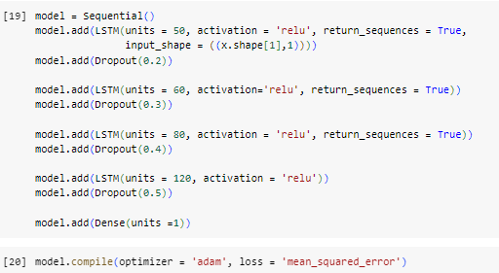
Building Neural Networks
It's designed to learn from historical stock price data to predict future stock prices.

Slide 6
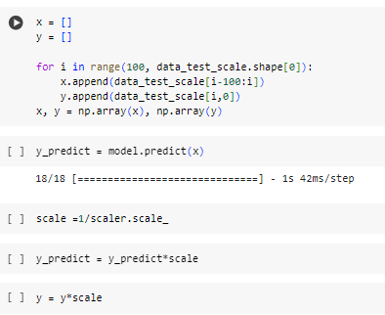
Testing Data and Make Predictions
Prepare the testing data, make predictions using the trained model, and scale back the predicted and actual target values to their original scale for evaluation.

Slide 7
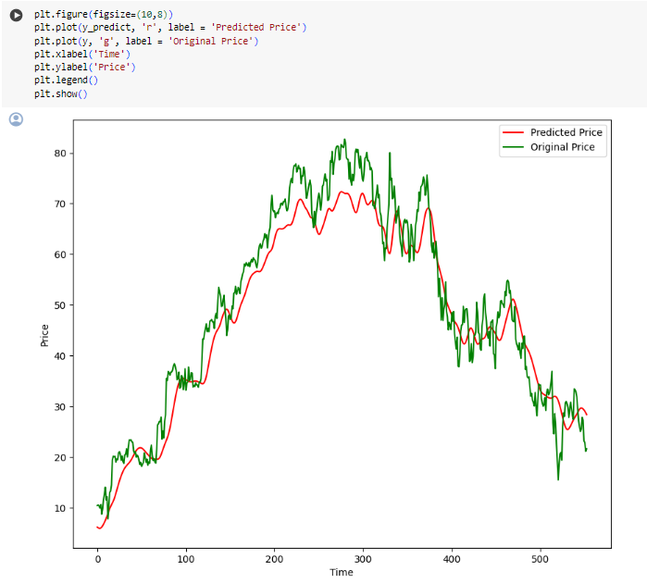
Predicted Prices and Original Prices
the resulting plot will show the predicted prices (in red) and the original prices (in green) of the stock overlaid on the same graph.

